Slide 1
Working principle of Hard Disk Controller
Md. Fazle Rabbi
ID:16CSE057

Slide 2
Presentation Outline
Introduction
Types of Hard Drives
Location of Hard Disk Controller
Tasks of Hard Disk Controller
Block Diagram of Hard Disk Controller
Disk Arrays
Disk Arrays Interface

Slide 3
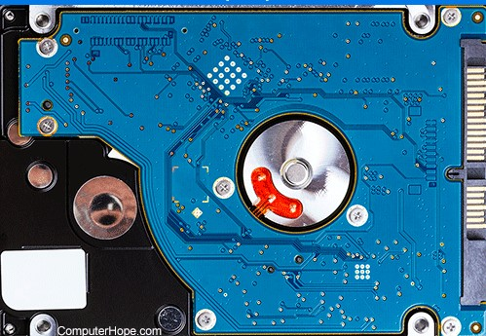
Introduction
Enables a computer to read and write information to a hard drive.
HDC allows the computer or its processor to control the hard disk.
Type and functions depend on the type of interface
Connect the hard disk to the rest of the computer's components.
Hard drives have the controller built on them.
Figure 1.1: Hard disk with controller

Slide 4
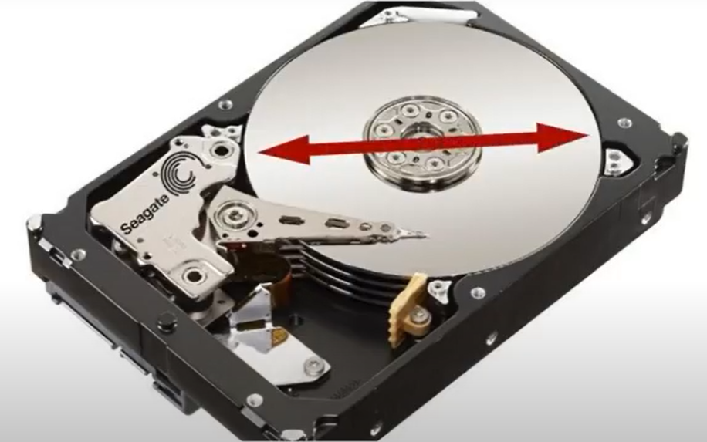
Types of Hard Drives
Hard disk drive (HDD):
Use one or more rotating discs and rely on magnetic storage.
Has high capacity storage.
Performance is relatively low.
Form factor may be 2.5 inch or 3.5 inch.
Figure 1.2: Hard disk drive

Slide 5
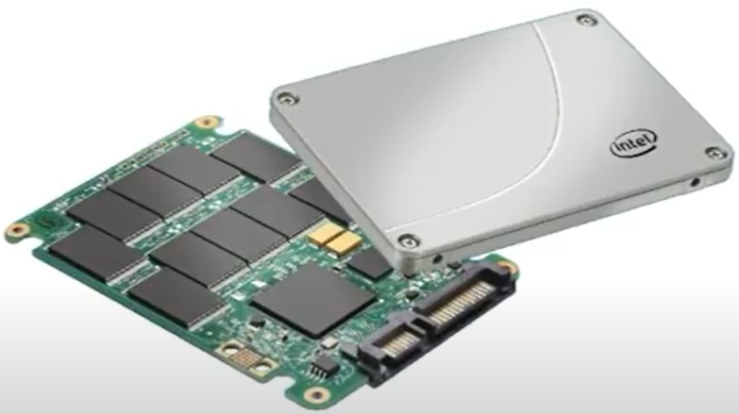
Types of Hard drives
Solid-state drives (SSD):
No moving part and data stored electrically instead of magnetically.
Use flash-based memory.
Not very high capacity storage.
Performance is relatively high.
Low power consumption.
Figure 1.2: Hard disk drive

Slide 6
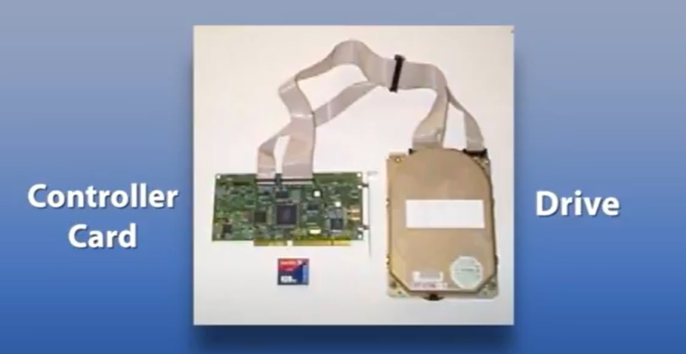
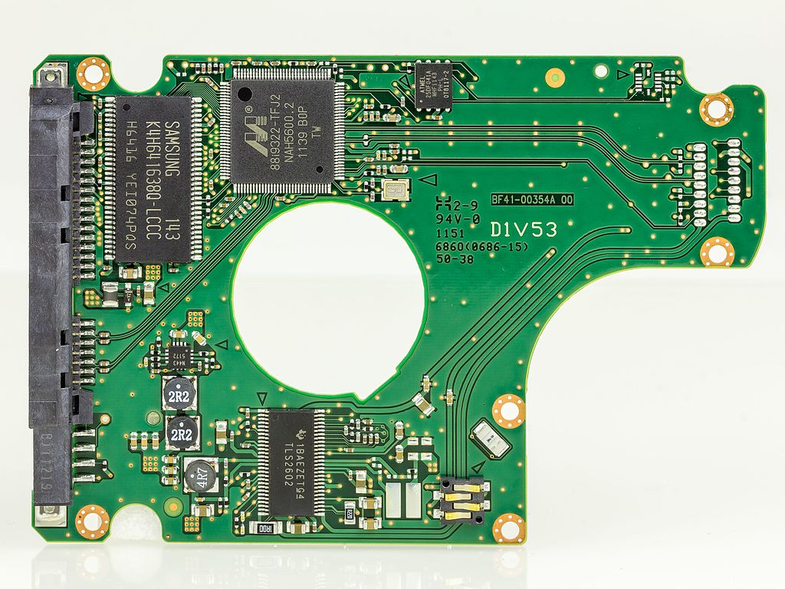
Location of Hard Disk Controller
Outside of hard drive
Inside of hard drive
Figure 1.3: Hard disk drive and controller
Figure 1.4: Disk controller

Slide 7
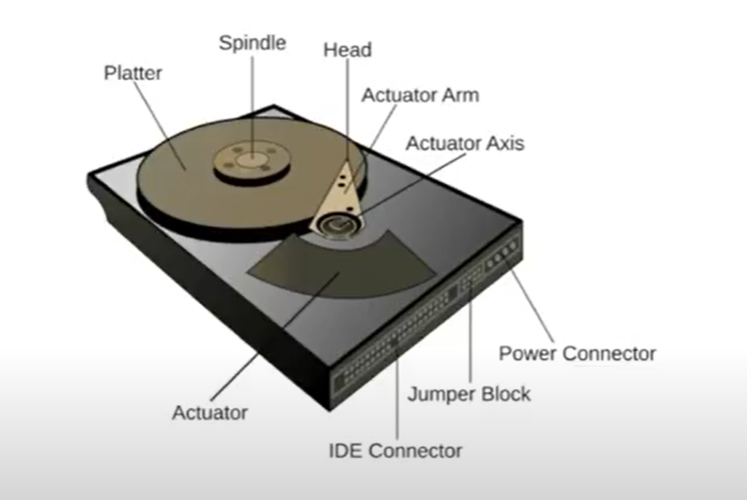
Tasks of Hard Disk Controller
Spinning the disk.
Moving the heads.
Transferring the data
Figure 1.5: Hard disk controller

Slide 8
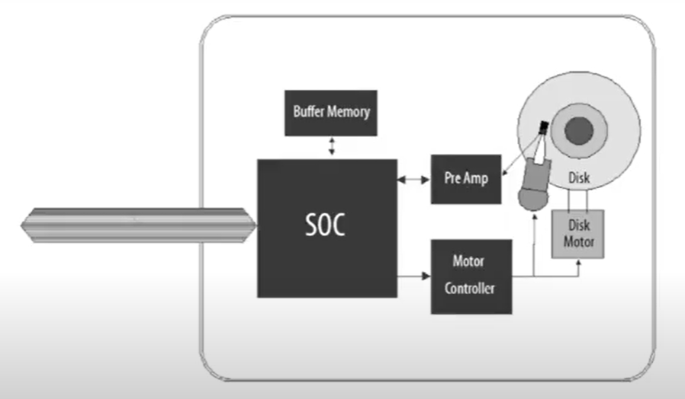
Block Diagram of Hard Disk Controller
Figure 1.5: Block diagram of hard disk controller

Slide 9
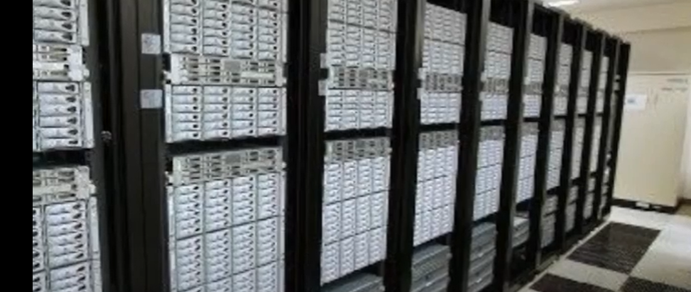
Disk Arrays
Contains large number of disk drive and put together under control of one or more controllers.
Can work as a server of one computer or is shared between many computer.
Increase the availability and maintainability.
Can connect without switching of power.
Figure 1.5: Disk arrays server

Slide 10
Disk Arrays Interface
Back-end interface
Front-end interface
Communicates with controller disks
Protocol used – PATA, SATA, FC
Communicates with a computer host adapter.
Protocol used – ATA, SATA.

Slide 11
THE END

